Slide 1

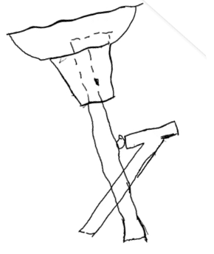
Zhejiang University - University of Illinois at Urbana Champaign Institute
Shelter – a ingenious combination of an umbrella and a portable seat
ME270, LA1, Team #4
Qingran Wu
Yanbo Chen
Zhiliang He
Sicheng Lu
10/7/2022

Slide 2



Product Description
In the rain, although you feel tired, you have to stand and hold an umbrella.
Notes:
Our design combines umbrella stick with folding chair, which allows users to not only use our product as an umbrella or a folding chair, but also sit at the chair and be under the umbrella without holding the umbrella by hand.

Slide 3
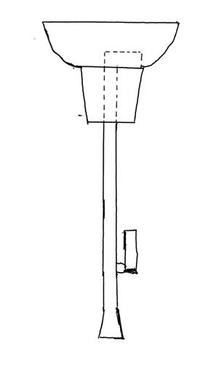
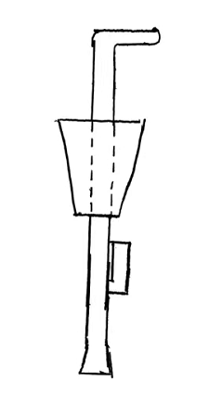
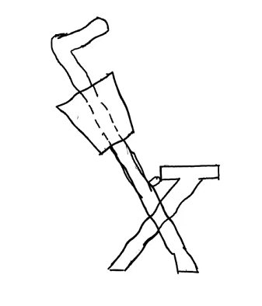
Product Description
Original State
“Chair” State
“Umbrella” State
“Umbrella + Chair” State
Notes:
Hardest challenge:
1. How to deal with the connection parts between the umbrella and the chair?
2. How to create enough room in the umbrella stick for the umbrella to open and close?
3. How to determine the specific tilt angle of the umbrella so that the rain does not fall on the chair?

Slide 4
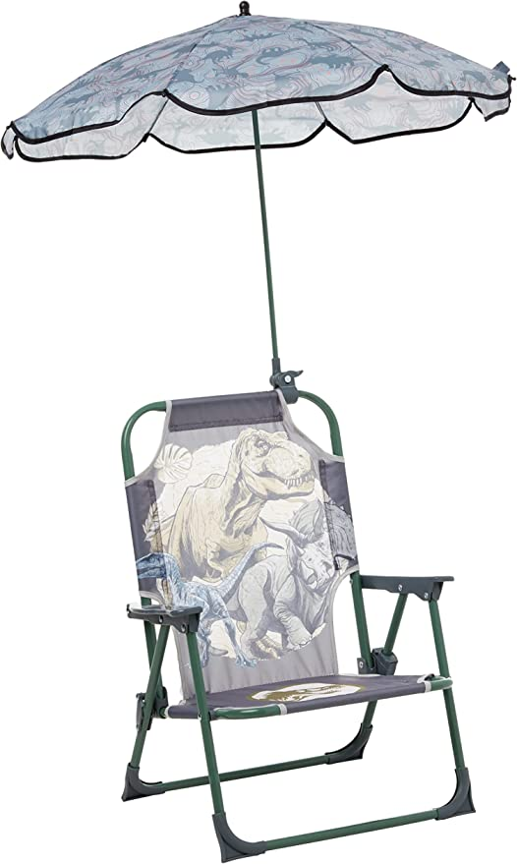
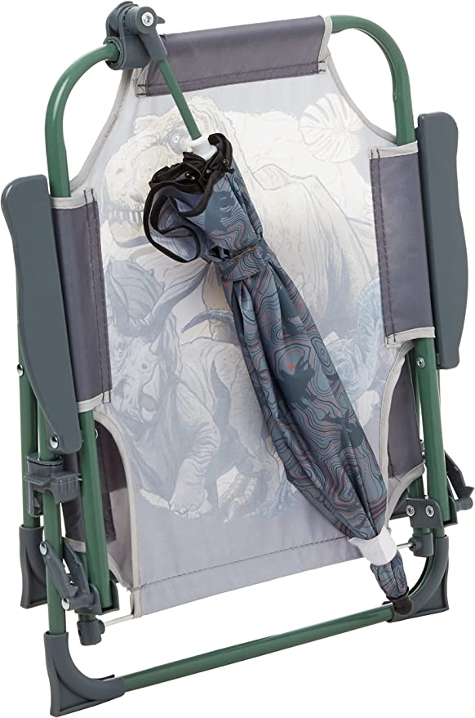
Background Research
Foldable
Detachable
Comfortable
￥444
Notes:
This product is a combination of an umbrella and a chair. Its folded state is shown in the picture on the left, fixing an umbrella on the back of the chair, thus reducing the space taken up in the folded state. If you need to use this product, you should first unfold the chair, and then open the umbrella. It is worth noting that the umbrella and the top end of the chair where there is a device to adjust the tightness, which allows us to adjust the angle of the umbrella and make the umbrella not fall down.

Slide 5
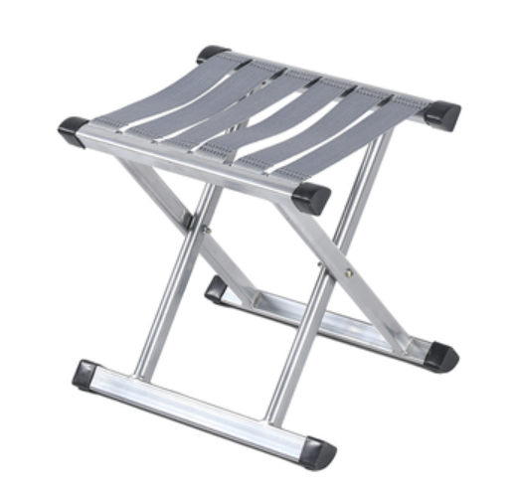
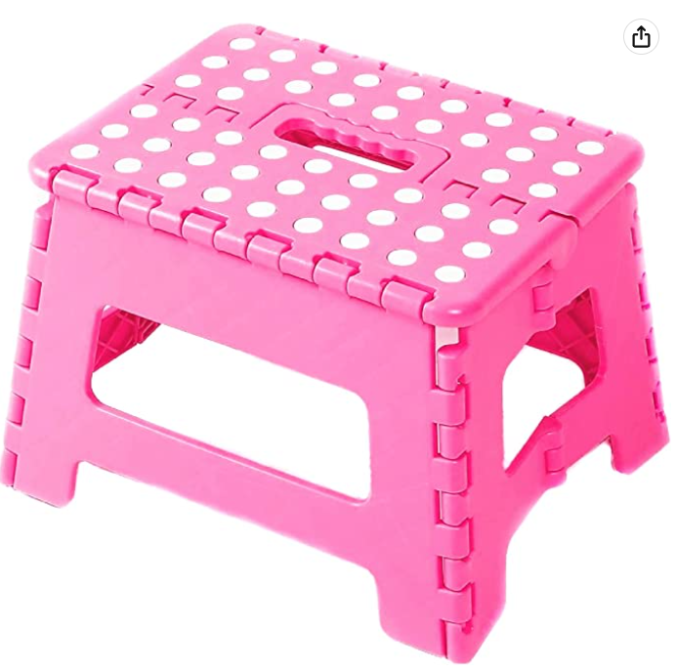
Background Research
Portable
Small
￥17.5
￥15
Notes:
These two products are relatively similar. They are both very portable as well as small, and they are also very cheap. The product on the left in the folded state is the left and right two rods close together, when using just separate the two rods can become a chair. The product on the right is similar to the one on the left, and it is used in the following way: the legs on both sides are closed in the folded state, and when you use it, you only need to spread it to both sides to turn it into a chair.

